Slide 1




Market Report
INDUSTRIAL
SNAPSHOT​
3rd Week of June, 2026
[15th June 2026 - 21th June 2026]

Slide 2
INTRODUCTION
Dear esteemed readers,
CNCIndustrial is pleased to introduce our 'Industrial Snapshot' section – your go-to source for the latest information and in-depth analysis on Vietnam's industrial sector and industrial real estate market. We understand that making informed investment decisions requires a deep understanding of the market. Therefore, our team has compiled and analyzed key information, including macroeconomic trends, market overviews, noteworthy projects, the industrial and logistics ecosystem, as well as the most recent investment support policies. We hope that this information will serve as a valuable resource, assisting you in making effective investment decisions.

Slide 3

Executive Snapshot
Weekly Market Highlights
International News
[1] Fed Holds Rates, Signals Prolonged Tightening
[2] US-Iran Deal Raises Hopes of Easing Asia’s Oil Supply Pressure
Viet Nam News
[3] Vietnam’s Trade Value Nears USD 500 Billion
[4] New Regulations on Construction Investment Cost Management

Slide 4
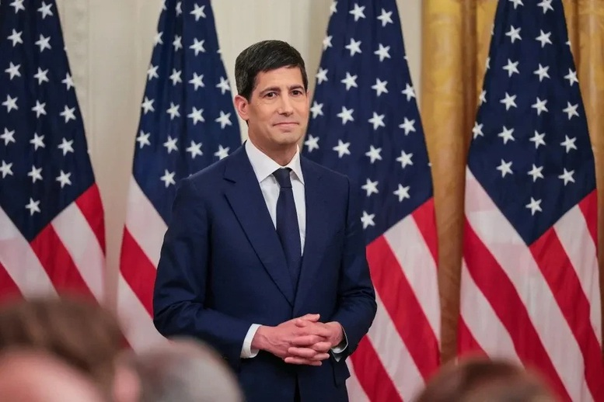
International News
[1] Fed Holds Rates, Signals Prolonged Tightening
On June 17, the Fed decided to keep its benchmark interest rate unchanged at 3.5%–3.75%, marking the first meeting chaired by new Chair Kevin Warsh. The FOMC unanimously kept rates unchanged for the fourth consecutive meeting.
The Fed raised its 2026 inflation forecast, with headline inflation at 3.6% and core inflation at 3.3%, higher than the 2.7% projection released in March. The GDP growth forecast was slightly revised down to 2.2%.
The Fed removed signals paving the way for rate cuts and shifted toward a message of maintaining tighter policy for longer. Markets no longer expect the Fed to cut rates in 2026 and are pricing in a higher probability of a rate hike by year-end.
Source: baochinhphu.vn

Slide 5
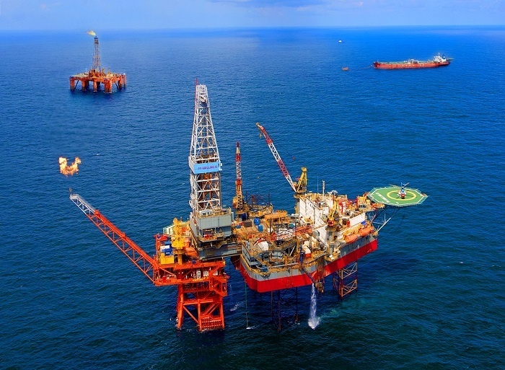
[2] US-Iran Deal Raises Hopes of Easing Asia’s Oil Supply Pressure
The US-Iran deal opens the prospect of restoring tight oil supplies, helping ease energy price pressure in Asia. The development provides a positive signal after the region faced significant supply-side pressure.
However, the recovery of oil supply cannot take place immediately, with a delay that could last several months. This indicates that energy pressure in Asia remains present in the short term.
The deal creates positive expectations for the regional oil market, but its actual impact depends on implementation progress and the ability to restore supply flows. Asian economies still need more time to reduce energy shortages.
Source: vnexpress.net

Slide 6
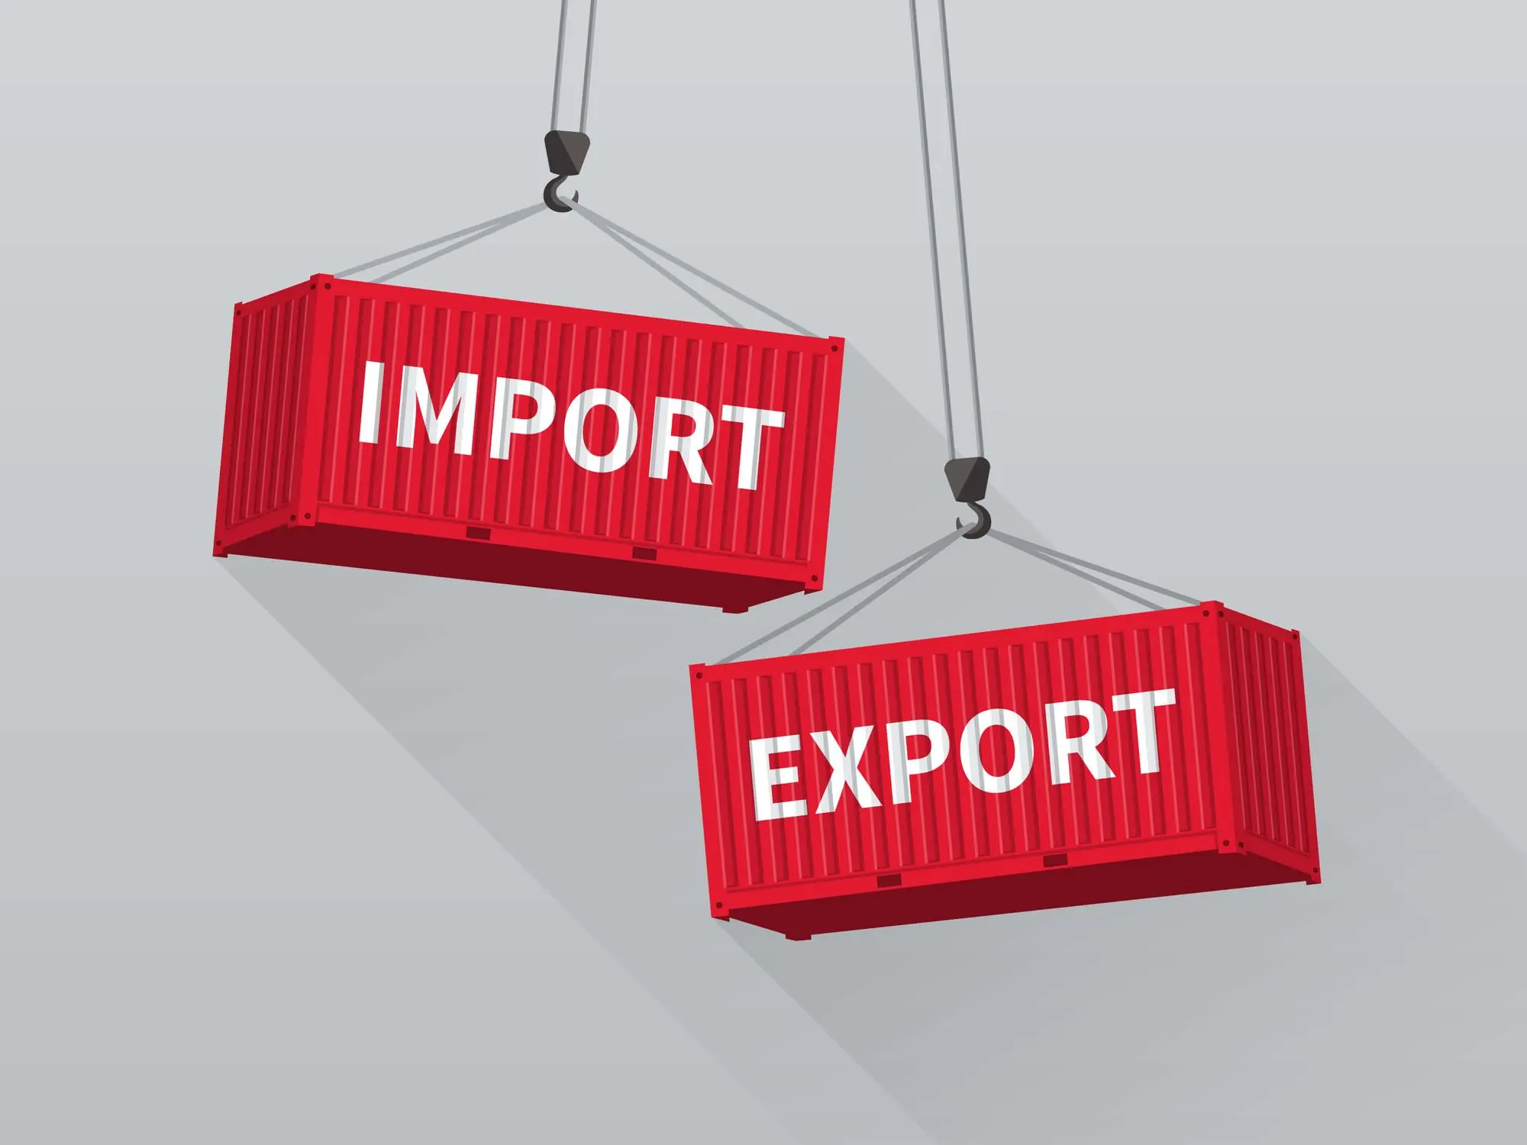
Viet Nam News
[3] Vietnam’s Trade Value Nears USD 500 Billion
In the first half of June (June 1–15), Vietnam’s total import-export turnover reached USD 51.2 billion, including USD 24.2 billion in exports and USD 29 billion in imports. The trade balance continued to record a deficit of USD 2.8 billion.
Five export groups posted turnover of USD 1 billion or more, led by computers, electronic products and components with USD 7.3 billion. Other major groups included machinery and equipment, phones, textiles and footwear.
As of June 15, total import-export turnover reached USD 496.6 billion, including USD 239.9 billion in exports and USD 256.7 billion in imports. Vietnam recorded a trade deficit of USD 16.8 billion from the beginning of the year.
Source: thuehaiquan.tapchikinhtetaichinh.vn

Slide 7
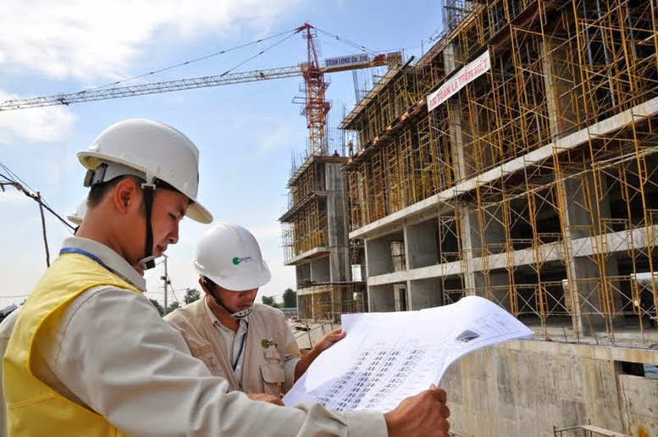
[4] New Regulations on Construction Investment Cost Management
The Government issued Decree No. 206/2026/ND-CP dated June 15, 2026 on construction investment cost management, effective from July 1, 2026. The decree covers total investment, construction estimates, bidding package prices and related cost items.
Construction investment costs must be consistent with design, standards, regulations, technical instructions and applied technologies. This serves as the basis for selecting contractors, investors and managing construction contracts and PPP project contracts.
Provincial People’s Committees are responsible for promptly publishing prices of materials, labor, machine shifts, construction equipment and construction price indices.
Source: baochinhphu.vn

Slide 8
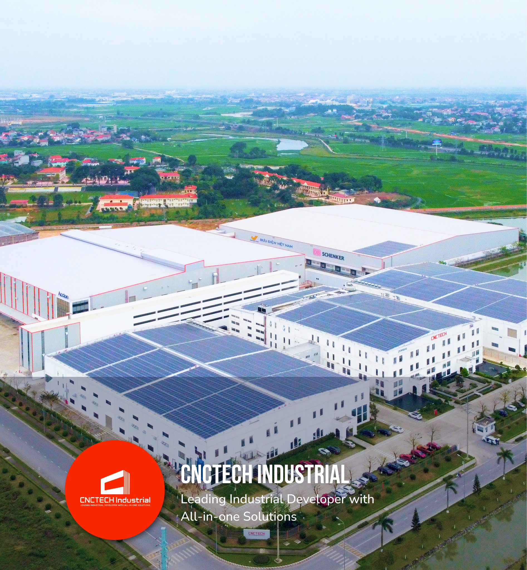
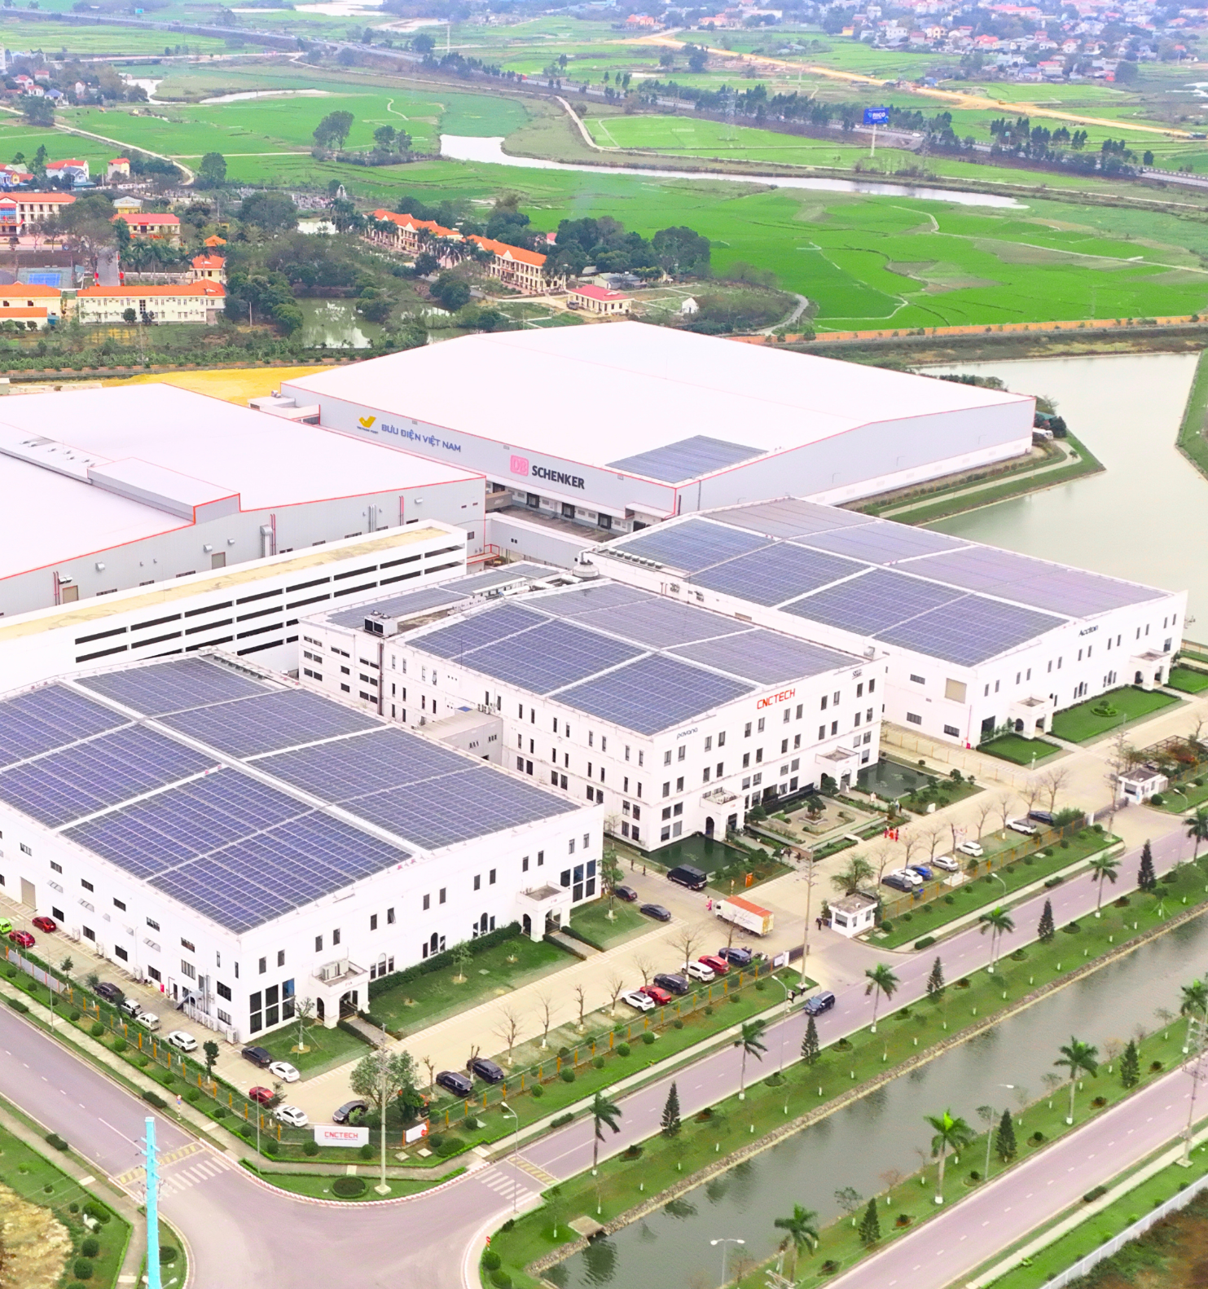


Contact us
cisgroup.vn
hello@cisgroup.vn
(+84) 866 505 509
Thang Long III, Binh Nguyen Commune, Phu Tho Province, Vietnam

Slide 9



Point of contact
Nguyen Phuong Nga (Mrs)
Luu Van Trung (Mr)
Deputy General Director CNCTech Group
Sales Manager CNCTech Group
nganp@cnctech.vn
Trunglv@cnctech.vn

Slide 10

THANK YOU!

